Slide 1
Managing Jobs using TOS
February 15, 2018
Presenter :

Slide 2
Managing Jobs using TOS
Job versions
Exporting a project
Importing a project
Exporting jobs
Importing jobs
Build a job for execution

Slide 3
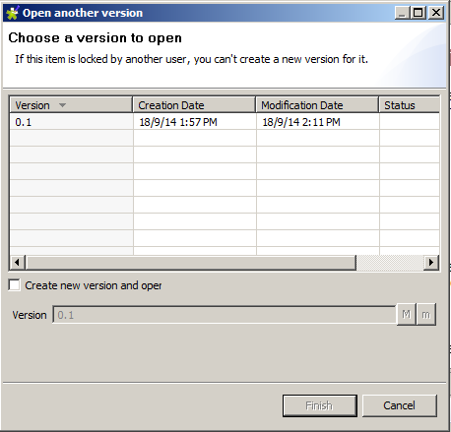
Job versions
While the Studio does not contain a full-featured version control system, it does have some features which allow developers to manage software versions.
We can create a new version of this job by right-clicking on the job in the Repository view and selecting Open another version. This will open the job version pop-up window.

Slide 4
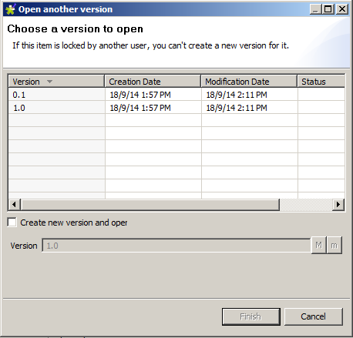
Job Versions continued...
If we want to create a new version, tick the checkbox labelled Create a new version and open it? and click the m or M button to increment the version number.
m – minor increment in version, 0.2 from 0.1
M – increments the major version, that is 1.0, 2.0, 3.0, and so on

Slide 5
Job Versions – Some key points
Some key points to note are as follows:
New versions are created from the latest version only.
Should you want to revert back to an older version (for example, version 0.3 based on version 0.1) you can create a new version, delete all of its components, open version 0.1, and copy and paste the components from version 0.1 into version 0.3.
Only the latest version of a job can be edited. All other older versions are read only.

Slide 6
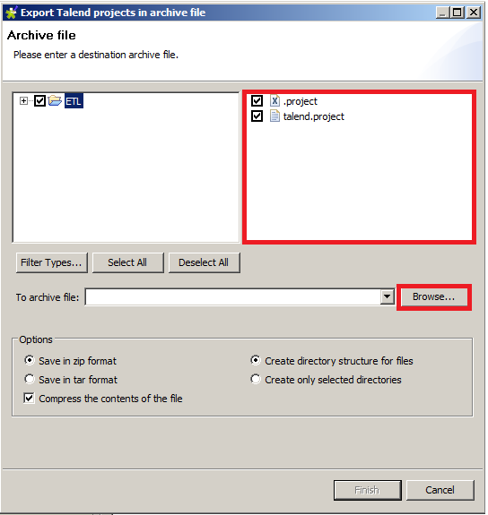
Exporting Project
Click on the Export Talend projects toolbar button above the Repository window.
Click on the project to highlight it.
Click on the Browse... button and browse the directory where you want to save the project export.
Finally, click on Finish to run the export process.

Slide 7
Importing project
There are two ways in which developers can import a project into the Studio.
from the Studio start up screen
from within the Studio itself.

Slide 8
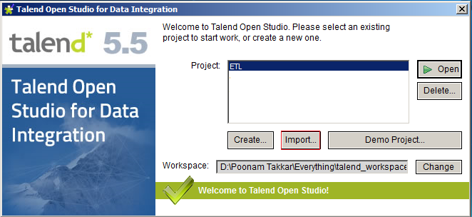
Importing project – startup screen
1. Start up the Studio and on the logon screen, click on Import.

Slide 9
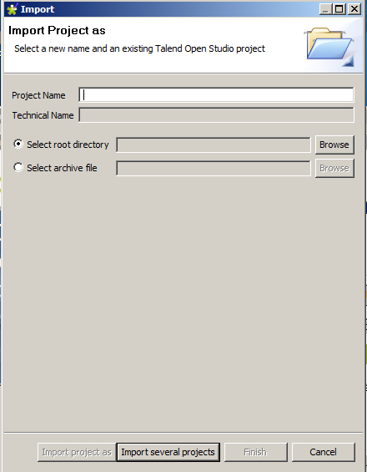
Importing project – startup screen
2. Enter a new project name and click on the Browse button of Select root directory to browse to your previously exported project files.
3. Click on Finish.
If your project export is contained in an archive file, you can choose the second option Select archive file, rather than Select root directory.
Copyright © 2014 by Vikram Takkar. All Rights Reserved..

Slide 10
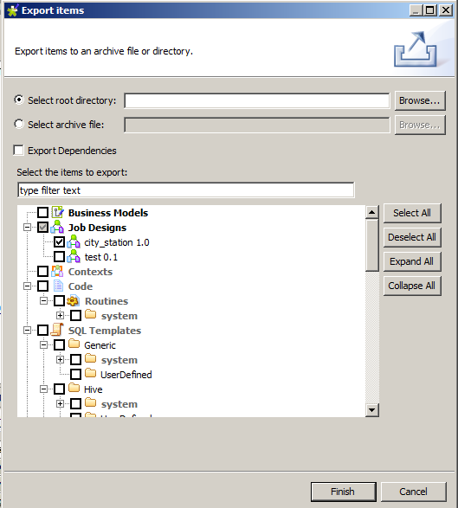
Exporting a job
In the Repository window, expand the Job Design section and select a job to export.
Right-click on the job and select Export items. The Export items pop-up window will appear.

Slide 11
Exporting a job
The job that you chose to work with will be pre-selected, but you also have the option to select additional jobs at this point if you wish.
You can choose to export the job as a set of files in a directory or a set of files in a zipped archive.
We can also, optionally, decide to export any dependencies of the job.
Click on Finish to run the export process.

Slide 12
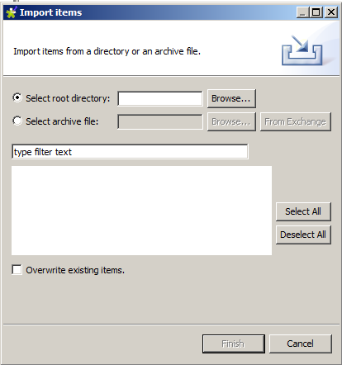
Importing jobs
In the Repository window, right-click on Job Designs and select Import items.
Click on the Browse button of Select root directory and browse to the directory where your job export is stored.
Click on OK and the job will appear in the Items List window.

Slide 13
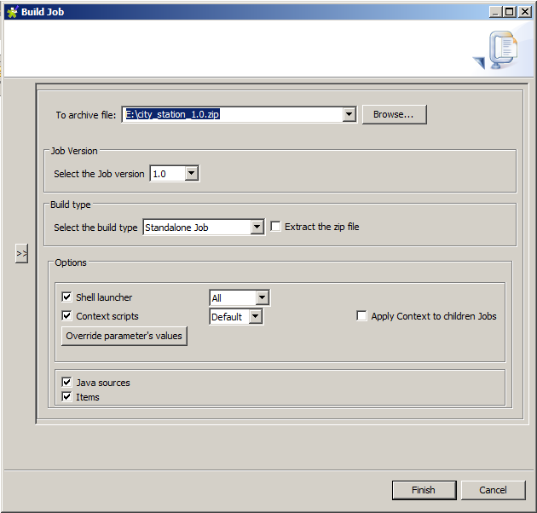
Exporting a job for execution
In this type of export, the Studio compiles the code into a standalone executable format and packages up all of the necessary files to support this.
Choose a job from the Repository window and right-click on it, selecting Build Job.
Click on the Browse button to select a directory and archive the file to export to.
Select from the Job Version drop-down box to make your choice.

Slide 14
Exporting a job for execution
Click on the Export Type drop-down menu to see the options.
The export process
creates a .bat file (for Windows) or a .sh file (for Linux/Unix) that can be used to execute the job in a standalone manner.
Click on Finish.
Copyright © 2014 by Vikram Takkar. All Rights Reserved..
Copyright © 2014 by Vikram Takkar. All Rights Reserved..

Slide 15
Questions?
Copyright © 2014 by Vikram Takkar. All Rights Reserved..

